Slide 1


Slide 2
ORDS & APEX
17.07.2024
More than just delivering Apps

Slide 3
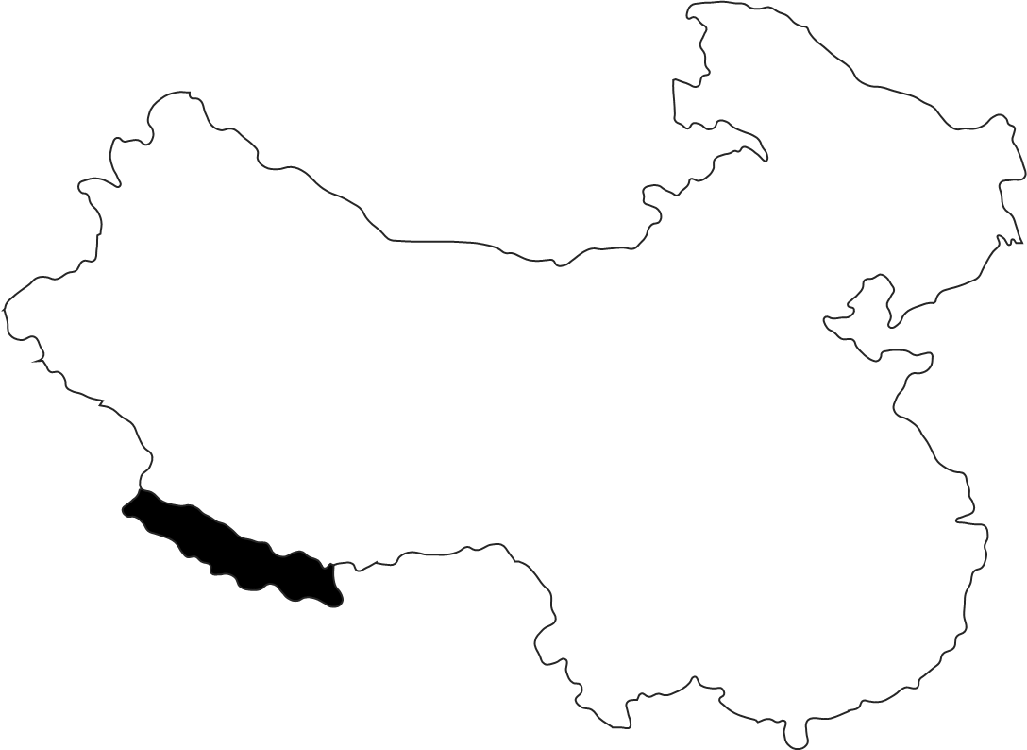
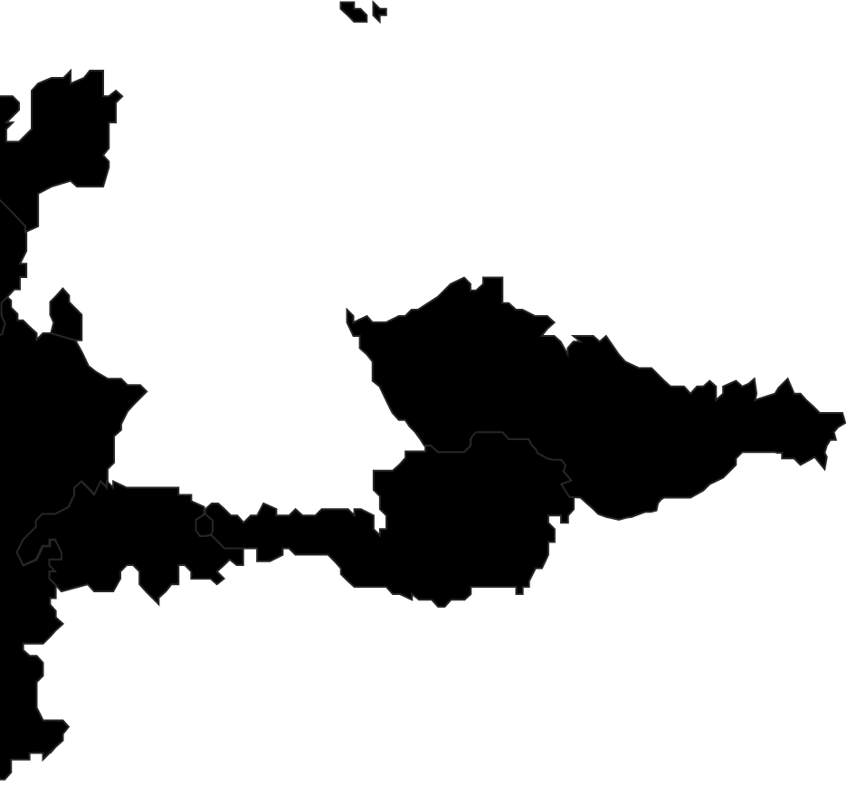


Kaunas
Vilnius
Hamburg
Berlin
Two become
Wolfsburg
Braunschweig
Ranked among the top 15 IT service providers in Germany
Dortmund
Ratingen
Wrocław
Cologne
Frankfurt
Ingolstadt
Munich
Pune
> 900 Employees (of which 160 in shoring locations)
> 150 Clients
> 10 Industries
16 Locations

Slide 4
Let's start with a little quiz

Slide 5
ORDS was called APEX Listener
True

Slide 6
ORDS can be used to upgrade APEX
False

Slide 7
ORDS can clone Pluggable Databases
True

Slide 8
ORDS can be used to query Data Guard configuration
True

Slide 9
ORDS requires Enterprise Edition
False

Slide 10
ORDS can starve your Database
NULL

Slide 11
ORDS was created because
a certain Oracle employee refused to maintain mod_plsql
True

Slide 12
ORDS can play Country Music
False

Slide 13
Demo Time
List PDBs
Clone PDB
Show APEX Instance Information
Show Database Users
Show Tables of a Database User

Slide 14
ORDS 24.2 Documentation
Landing Page
Oracle REST Data Services API
Installation & Configuration Guide

Slide 15
Sources on Github
https://github.com/commi235/ords-and-apex

Slide 16
Tools by Us
Low Code Testing Tool (lct.software)
Flows for APEX (flowsforapex.org)
And more (apex.hyand.com)

Slide 17


Slide 18
Moritz.Klein@hyand.com
Say Hy_

